Slide 1








Team Introduction
Deepika S
Akash M
Deepak V
Dhyanesh M
Team Lead · ML engineer
Frontend & UX developer
Data source & Product
Backend Developer
  Develops and evaluates ML models
  Handles API integration and technical architecture
  Leads the pitch and overall project coordination
  Builds the React dashboard and UI
  Designs data visualizations and user experience
  Handles the live demo and frontend flow
  Prepares and validates the project dataset
  Defines metrics and evaluates model results
  Handles the business case, requirements, and product story
  Develops backend APIs and server logic
  Connects ML models with the application
  Handles database integration and system performance
TEAM SENTINEL
Working title: Sentinel, Explainable Predictive Maintenance
Python
XGBoost
SHAP
React
Node.js
MySQL
Notes:
Introduce each person with a one-line role. Edit teammate names on this slide before submitting. Clear role split signals we can execute.
2

Slide 2

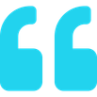
Problem Statement
  The problem: machines break without warning, so plants fix them only after they fail
  Who hurts: plant managers, maintenance engineers and technicians
  Example: a cutting tool wears out mid-shift, the line stops, scrap piles up
  Why AI fails here: black-box alerts get ignored because nobody can see the reason
$1.4T
lost every year by the world's 500 biggest companies to unplanned downtime (≈11% of revenue)
₹222.78 M
An ounce of prevention is worth a pound of cure.
BENJAMIN FRANKLIN
for every hour an automotive line stands idle (more than $₹58.1K a second)
Source: Siemens, The True Cost of Downtime 2024
2
Notes:
Judges should feel the pain in 10 seconds: downtime is brutally expensive and most plants still react after the failure. Stats: Siemens True Cost of Downtime 2024.
3

Slide 3





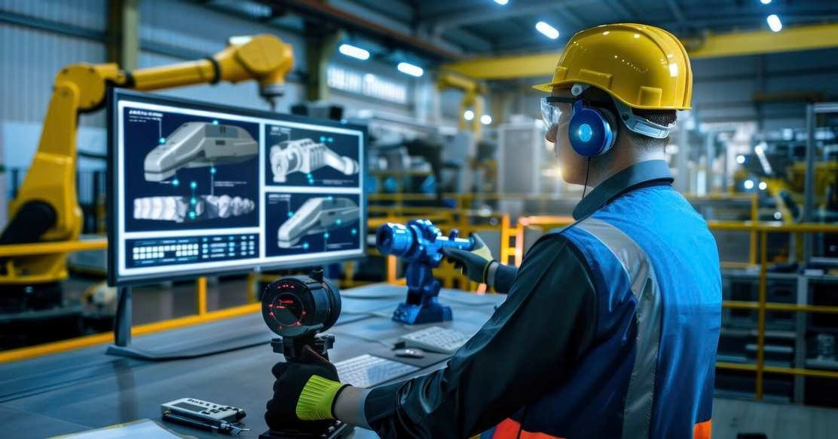
Proposed Solution
1
2
3
4
Upload
Predict
Explain
Act
Sensor CSV is validated before any database write
6 models score each machine: overall plus 5 failure modes
SHAP shows why, with a ranked list of fixes
Engineer approves, technician fixes, manager verifies
WHAT MAKES IT DIFFERENT
  Not a black box: every score comes with a reason
  What-if simulator finds a lower-risk setting
  Never auto-stops a machine; humans stay in charge
AI recommends. Humans approve.
3
Notes:
Walk the 4-step flow left to right. Emphasise the difference: explainability plus a human-approved workflow, not just an alert.
4

Slide 4







Tech Stack & Architecture
React 19 + Vite
Node.js + Express
FastAPI ML service
JWT
internal
10 pages · Recharts · animated machine avatar
JWT auth · role checks · 33 REST endpoints
XGBoost · SHAP · rule-based recommender
3 user roles
MySQL 8 · 9 tables
6 trained models
Engineer · Technician · Manager
readings, predictions, SHAP, tasks
overall + TWF · HDF · PWF · OSF · RNF
AMBITIOUS & PROUD OF
HONEST: FUNCTIONAL VS. SIMULATED
  SHAP reason behind every prediction
  10,000 readings scored in about 74 s
  Server-enforced 3-role workflow with SLAs
  Functional: upload, 6 models, SHAP, what-if, tasks
  Simulated: AI4I-style sensor data and repairs
  Never connects to or controls a real machine
4
Notes:
Client, server, data, integrations. Python stays as a thin internal microservice because XGBoost and SHAP are Python-only. Be upfront that the dataset is simulated.
5

Slide 5

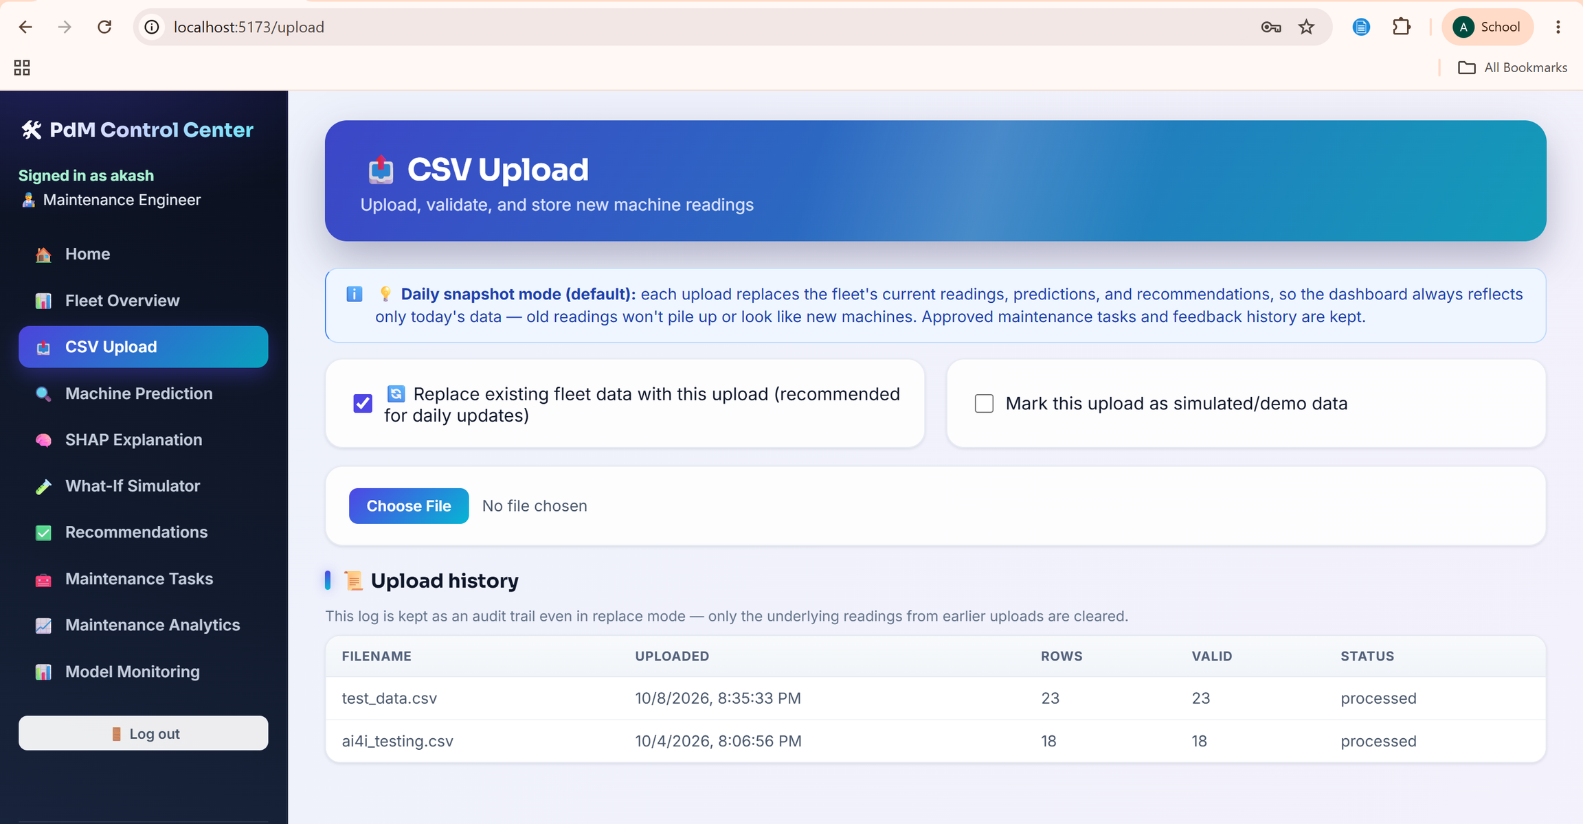
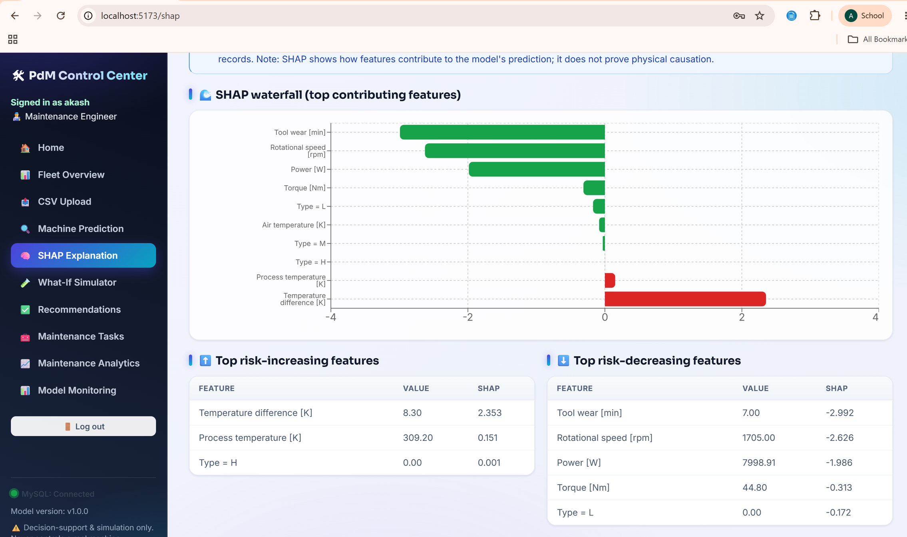
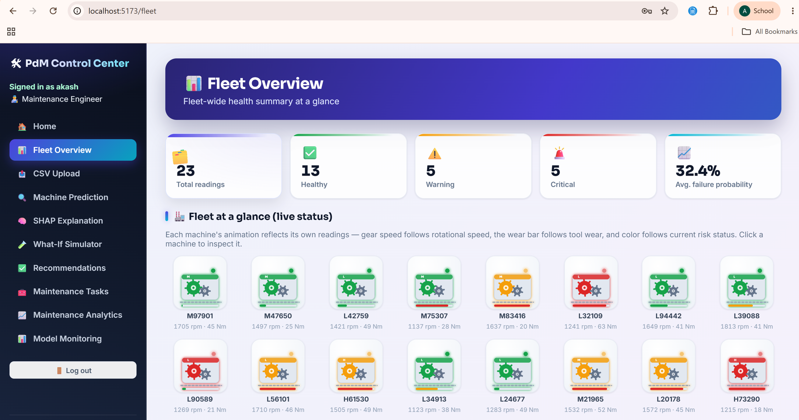
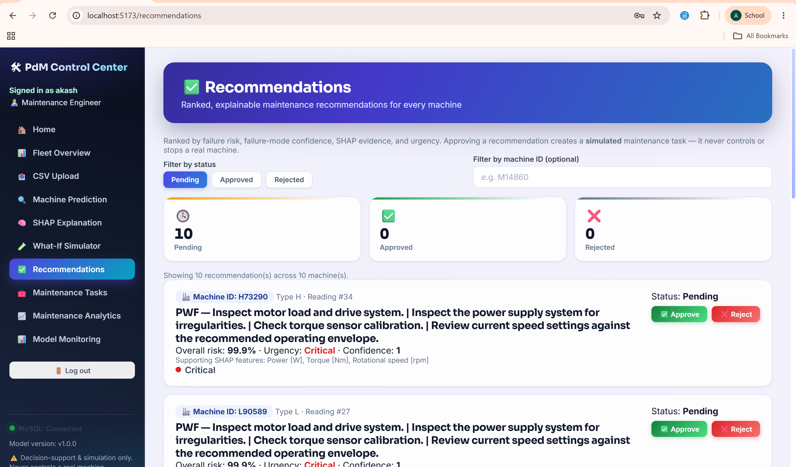
Prototype / Demo Walkthrough
Notes:
Follow the same order live: upload, fleet overview, explain, recommend and act. If the live demo hiccups, this slide proves the build works. Replace with real screenshots if you want pixel-accurate visuals.
6

Slide 6



Innovation & Uniqueness
IMPROVING ON: THRESHOLD ALARMS AND BLACK-BOX ML DASHBOARDS
Typical tools
Sentinel
Black-box risk score
SHAP reason for every score
One sensor, one threshold alarm
6 models: overall + 5 failure modes
Alert ends at "go check it"
What-if finds a lower-risk setting
No trail of who fixed what
Role-gated tasks, 24h verify SLA
Sentinel doesn't just predict a failure: it explains it, tests the fix, and tracks it to closure.
Notes:
If every team could describe our idea the same way it would not be distinct. Our edge is the full loop: predict, explain, simulate, assign, verify.
7

Slide 7

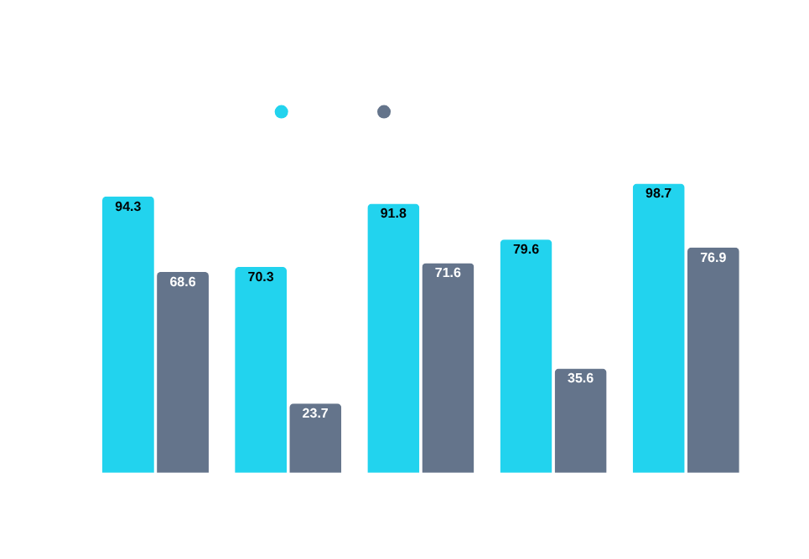
Implementation Feasibility
BUILT AND RUNNING
  Full stack tested live with real MySQL
  10,000 readings scored in about 74 s
  23 regression tests on the ML service
  Upload, SHAP, what-if, tasks, analytics
PROTOTYPE → PRODUCTION NEEDS
  Live sensor feed instead of CSV upload
  Retrain on real plant data
  Harden security and monitoring
KNOWN LIMITS
Simulated AI4I-style data
70% precision: 94 false alarms vs 223 caught
Random failures: 8 cases, unpredictable
7
Notes:
Be candid: XGBoost beats the logistic baseline, but precision is about 70 percent so some alerts are false alarms. Random failure (RNF) has only 8 positives in 10,000 rows, so no model can learn it. Self-awareness reads as maturity.
8

Slide 8




Impact & Scalability
10 hrs
₹12.1M
₹121.08M.
×
=
unplanned downtime avoided per line a year (our assumption)
average cost of one downtime hour (ABB, Value of Reliability)
saved per production line, every year
BUSINESS MODEL
  Reach: any plant with machine sensor logs, starting with MSME manufacturers
  Scale: stateless Node API and ML service scale out independently
  Impact: less scrap, wasted energy and safety risk from sudden breakdowns
  Honest note: 10 hours is illustrative; a pilot will validate it
Customer
Plant and maintenance heads
Revenue
Per-machine monthly SaaS
Channel
Pilots with MSME clusters
Notes:
Show the math: hours avoided x cost per hour. The 10 hours is an assumption, labelled as such. Business model: per-machine monthly subscription, starting with pilots at MSME plants.
9

Slide 9


Challenges & Learnings
CHALLENGE 1 · SILENT AND LOUD ML BUGS
≈20,000
  Symptom: 500 errors, and lowercase machine types gave silently wrong scores
  Fix: validate and coerce every input, return clear 400 errors
  Safety net: 23 regression tests cover each failure
≈80
round-trips for 10,000 readings
CHALLENGE 2 · SCALE
WITH MORE TIME
  Symptom: 2 HTTP calls per reading made big uploads crawl
  Pivot: batch endpoints, bulk inserts, chunks of 250
  Result: 10,000 readings scored in about 74 s
  Calibrate risk probabilities
  Handle rare failure classes
  Train on real plant data
Fall seven times, stand up eight.
JAPANESE PROVERB
Notes:
Two real challenges. First, bad input caused 500s and one silent wrong prediction, so we added validation and tests. Second, per-reading HTTP calls did not scale; batching fixed it. Round-trip numbers: about 2 calls x 10,000 versus 2 batch calls x 40 chunks.
10

Slide 10


Future Roadmap & Ask
NEXT 30 DAYS
NEXT 90 DAYS
NEXT 6 MONTHS
Live sensor ingestion
Remaining-life forecast
Real plant pilot
MQTT / OPC-UA stream replaces CSV upload
Predict days left, alert technicians by SMS or WhatsApp
Retrain on plant data and monitor model drift
SUPPORT WE'D LOVE
OUR ASK
  Mentor from maintenance or industrial IoT
  Access to a pilot plant's real sensor logs
The best way to predict the future is to invent it.
ALAN KAY
Notes:
Three concrete next steps, then the ask: feedback, a pilot introduction, incubation support. End confident and forward-looking.
11

Slide 11




Thank You
TEAM LEAD
Deepika S
SENTINEL: Predict. Explain. Prevent.
deepika.s.2024.aids@rajalakshmi.edu.in
  Thank you, judges, mentors and organizers
  Explainable AI that keeps humans in charge
Add GitHub repo link or QR
End with confidence: this is your last impression on the judges.
ORGANIZER'S TIP
Notes:
Thank the judges, restate the tagline, put contact details and a GitHub QR on screen, then open the floor for Q&A.
12

Slide 12
12

